Slide 1
Project 1:
FoodHub Presentation
Julian Patton - PGP-DSBA-UTA-APR22-A2
June 9th, 2022

Slide 2
Contents / Agenda
Executive Summary
Business Problem Overview and Solution Approach
Data Overview
EDA - Univariate Analysis
EDA - Multivariate Analysis
Appendix

Slide 3
Executive Summary
Most customers are ordering from American and Japanese restaurants.
Average Cost of Orders: $16.49
Average Time For Food Prep: 27.37 Minutes
Most Customers will make their orders over the weekend vs. the weekday.
The quickest orders are delivered around 15 minutes.
Orders do not take longer than 33 minutes to deliver to customers.
Most orders are delivered between 25-29 minutes.

Slide 4
Executive Summary [Suggestions]
FoodHub should offer more promotional deals for American and Japanese restaurants to customers during the weekends.
Provide Discounts to frequent customers to reward users for FoodHub patronage.
Introduce a reward system to Incentivize customers to leave a review to help algorithm.

Slide 5
Business Problem Overview and Solution Approach
Business Problem: In New York, restaurants are opening up everyday. Lots of students and busy professionals rely on those restaurants due to their hectic lifestyles. Online food delivery service is a great option for them. It provides them with good food from their favorite restaurants. A food aggregator company FoodHub offers access to multiple restaurants through a single smartphone app. With the increasing demand from various users, FoodHub needs to analyze the data to obtain a fair evaluation of the demand for certain restaurants to enhance customer experience and provide an increase in app usability.
Solution Approach: Obtain records of the FoodHub Orders Excel CSV to observe data to determine key questions and determination. From the information provided from FoodHub, we will analyze the data and conduct univariate and multivariate analysis. We will provide visualization to support our findings. Our objective is to provide essential data to FoodHub key stakeholders to make an informed business decision for the application.

Slide 6
Data Overview
Data Dictionary:
order_id: Unique ID of the order (Integer) | rating: Rating given by the customer out of 5 (Integer)
customer_id: ID of the customer who ordered the food (Integer) | restaurant_name: Name of the restaurant (Object)
cost_of_the_order: Cost of the order (Float) | cuisine_type: Cuisine ordered by the customer (Object)

Slide 7
Data Overview
Data Dictionary Con’t:
day_of_the_week: Indicates whether the order is placed on a weekday or weekend (The weekday is from Monday to Friday and the weekend is Saturday and Sunday) (Object) | food_preparation_time: Time (in minutes) taken by the restaurant to prepare the food. This is calculated by taking the difference between the timestamps of the restaurant's order confirmation and the delivery person's pick-up confirmation. (Integer)
delivery_time: Time (in minutes) taken by the delivery person to deliver the food package. This is calculated by taking the difference between the timestamps of the delivery person's pick-up confirmation and drop-off information (Integer)

Slide 8
Data Overview
Shape Of Data:
There are 1898 Rows in the Dataset.
There are 9 Columns in the Dataset.
There are no missing values in the Dataset.
Statistical Data (Food Preparation):
Minimum Time For Food Prep: 20 Minutes
Median Time For Food Prep: 27 Minutes
Average Time For Food Prep: 27.37 Minutes
Maximum Time For Food Prep: 35 Minutes

Slide 9
Univariate Analysis
Unique Value Discovery:
There are over 1898 Order IDs.
There are 1200 Customer IDs.
There are exactly 178 Restaurant Names.
There are exactly 14 Cuisine Types offered in the data.

Slide 10
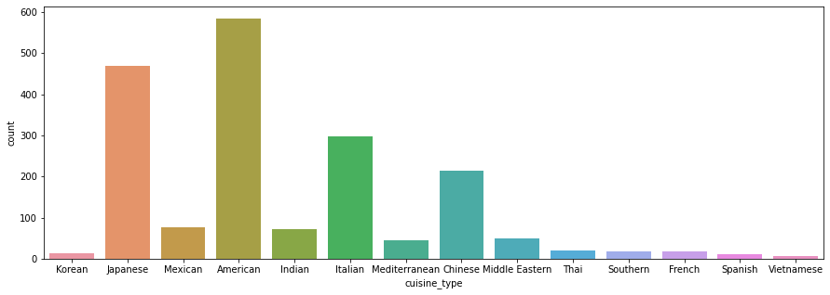
Univariate Analysis - Cuisine Types
Based of the data, most customers are ordering from American and Japanese restaurants.
Italian restaurants are slightly ordered more by customers than Chinese restaurants.
Customers are not ordering frequently from Thai, Southern, French and Korean restaurants.

Slide 11
Univariate Analysis - Cuisine Types (Con’t)
Spanish and Korean restaurants have a relatively equal demand in orders.
The Demand for Mexican and Indian restaurants are relatively equal.
The Demand for Mediterranean and Middle Eastern restaurants are relatively equal.
Very few FoodHub customers order from Vietnamese Restaurants.
.

Slide 12
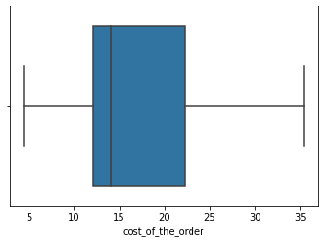
Univariate Analysis - Cost of Order
Minimum Cost of Orders: $4.47
Median Cost of Orders: $14.14
Maximum Cost of Orders: $35.41
Average Cost of Orders: $16.49

Slide 13
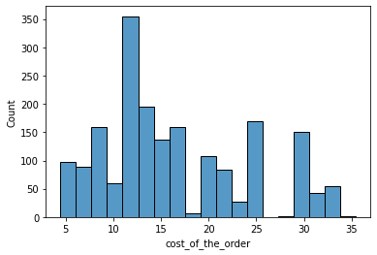
Univariate Analysis - Cost of Order (Con’t)
Y Axis: Count
X Axis: Cost of Order
There are no orders that cost over $35 or less than $5.
A Majority of the cost is between $13-$14
Very few orders cost between $26-$29

Slide 14
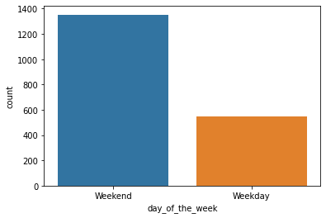
Univariate Analysis - Days of The Week
Y Axis: Count
X Axis: Day Of The Week
There are 1351 Orders Placed on the weekends.
There are 547 Orders Placed during the weekdays.
Customers are more likely to place orders on the weekends versus the weekdays.

Slide 15
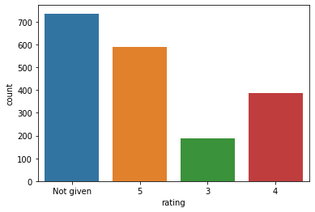
Univariate Analysis - Ratings
Rating Types:
5, 3, 4, Not Given
There are 736 orders that were not given.
There are 588 orders that were rated as a “5”.
There are 386 orders that were rated as a “4”.
There are 188 orders that were rated as a “3”.
A majority of the orders were not given, rated as a “5” and a “4”

Slide 16
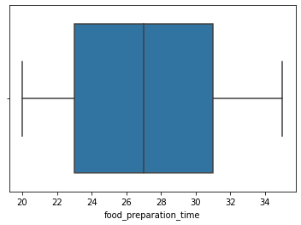
Univariate Analysis - Food Preparation Times
Food Preparation Times:
Minimum Time: 23 Minutes
Median Time: 27 Minutes
Maximum Time: 31 Minutes
Average Time: 27.37 Minutes

Slide 17
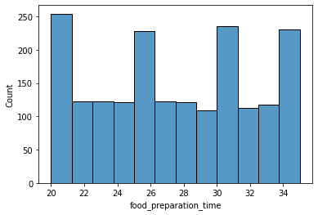
Univariate Analysis - Food Preparation Times (Con’t)
X Axis: Food Preparation Time
Y Axis: Count
Orders take at least 20 minutes to prepare.
Most orders do not take longer than 40 Minutes to prepare.

Slide 18
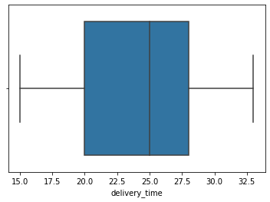
Univariate Analysis - Delivery Times
Minimum Delivery Times: 20 Minutes
Median Delivery Times: 25 Minutes
Average Delivery Times: 24.16 Minutes
Maximum Delivery Times: 33 Minutes

Slide 19
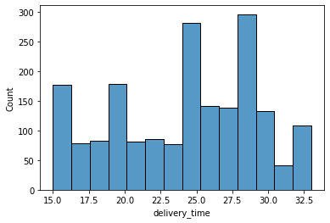
Univariate Analysis - Delivery Times
X Axis: Delivery Time
Y Axis: Count
The quickest orders are delivered around 15 minutes.
Orders do not take longer than 33 minutes to deliver to customers.
Most orders are delivered between 25-29 minutes.

Slide 20
Top 5 Restaurants
Top 5 Cuisines on Weekends
By Orders Received
Shake Shack 219
The Meatball Shop 132
Blue Ribbon Sushi 119
Blue Ribbon Fried Chicken 96
Parm 68
Top Cuisines on Weekends (Orders Received)
American 415
Japanese 335
Italian 207
Chinese 163
Mexican 53

Slide 21
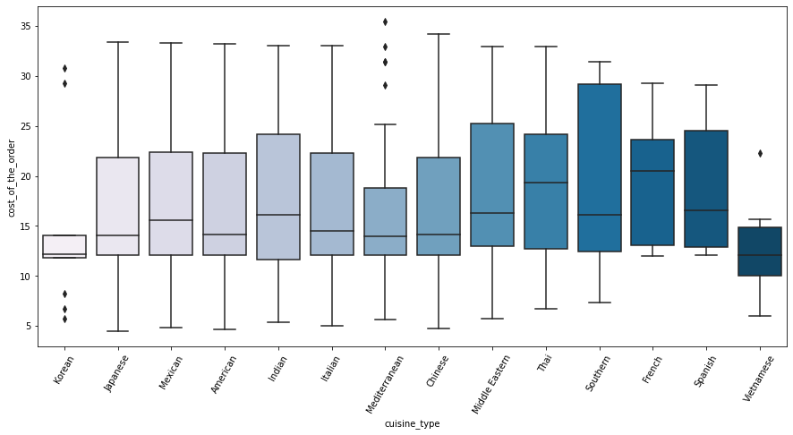
Multivariate Analysis: Cuisine vs. Cost of Order

Slide 22
Multivariate Analysis: Cuisine vs. Cost of Order
For some Mediterranean restaurants, the cost may be higher for some of their orders based on the outliers.
There is not a wide distribution for Korean and Vietnamese restaurants.
For most of the restaurants, 75% of the orders range in cost between $23-$27
For most of the restaurants, 50% of the orders range in cost between $12-$19

Slide 23
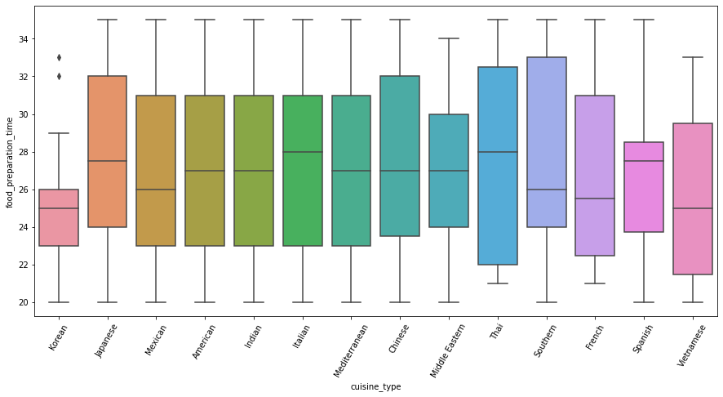
Multivariate Analysis: Cuisine vs. Food Preparation Time

Slide 24
Multivariate Analysis: Cuisine vs. Food Preparation Time
Korean restaurants takes the least amount of time to prepare their orders, however some orders take more time to prepare.
Southern restaurants takes the most amount of time to prepare their orders compared to other restaurants.
Majority of restaurants provide a median preparation time between 25-28 minutes.
For most of the restaurants, 75% of the orders provide a preparation time between 29 - 33 minutes.

Slide 25
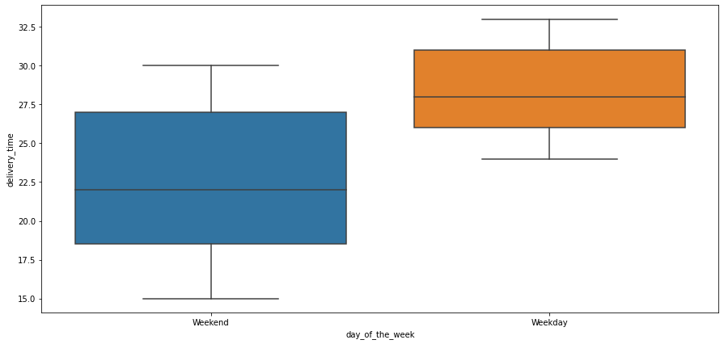
Multivariate Analysis: Day of The Week vs. Delivery Time
On the weekends, the median delivery time is around 21 minutes.
On the weekdays, the median delivery time is around 28 minutes.
The max delivery time on weekends is around 30 minutes.
The max delivery time is 32 Minutes during weekdays.

Slide 26
Revenue Generated From Restaurants
Shake Shack: $3579.53 Han Dynasty: $755.29
Blue Ribbon Sushi Bar & Grill: $666.62 Rubirosa: $660.45
Sushi of Gari 46: $640.87 Nobu Next Door: $623.67
Five Guys Burgers and Fries: $506.47 The Meatball Shop: $2145.21
Blue Ribbon Sushi: $1903.95 Blue Ribbon Fried Chicken: $1662.29
Parm: $1112.76 RedFarm Broadway: $965.13
RedFarm Hudson: $921.21 TAO: $834.50

Slide 27
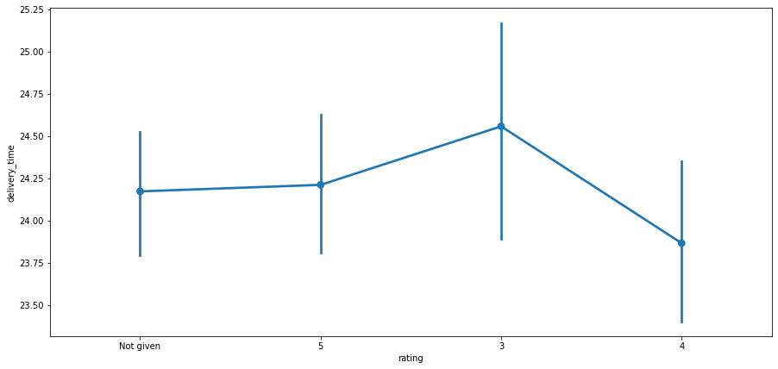
Multivariate Analysis: Rating vs. Delivery Time

Slide 28
Multivariate Analysis: Rating vs. Delivery Time
On average, customers do not provide a rating for orders that take slightly around 24.15 minutes to deliver.
This average slightly increases for a rating of 5 for orders that take 24.25 minutes to deliver.
Customers give a rating of 3 for orders that deliver around 24.50 minutes.
On Average, customers will provide a rating of 4 if the delivery is slightly under 24 minutes.
There is a high variation for customer ratings of 3.

Slide 29
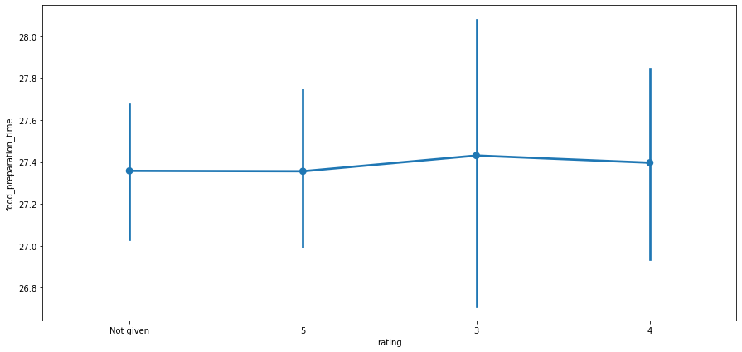
Multivariate Analysis: Rating vs. Food Preparation Time

Slide 30
Multivariate Analysis: Rating vs. Food Preparation Time
There is a high variation of rating of 3 based off the food preparation time. The average food preparation time for this rating is around 27.40 Minutes.
There is a lower variation for no ratings compared to the rest of the ratings. The average food preparation time for no ratings is around 27.30 Minutes. This is very close to a rating of 5 in the average food preparation time.
There is a slight increase in variation for ratings of 4 compared to 5 ratings. The average food preparation time for orders with a rating of 4 is slightly under 27.40 Minutes
Note: You can use more than one slide if needed

Slide 31
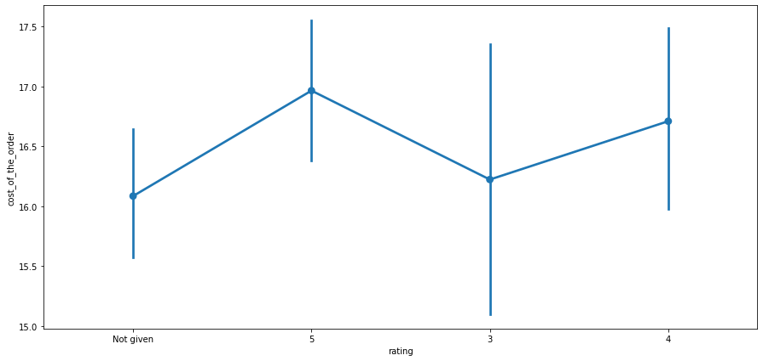
Multivariate Analysis: Rating vs. Cost of Order

Slide 32
Multivariate Analysis: Rating vs. Cost of Order
There is a high variation in the cost of the orders for customer ratings of 3. On average, if the order is around 16.25, a customer is more likely to provide this rating.
For orders with a rating of 5, the average cost is around $17
For Orders with no ratings displayed an average slightly above $16.10
For Orders with a rating of 4, the average cost is around $16.75.

Slide 33
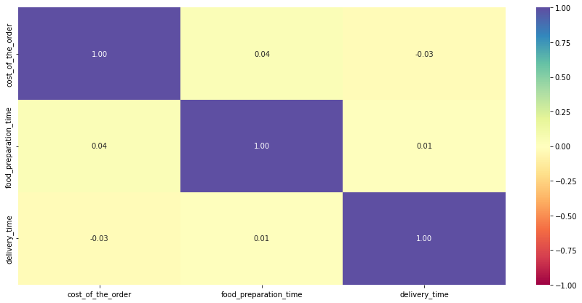
Correlation: Delivery Time, Food Prep Time, and Cost

Slide 34
Correlation: Delivery Time, Food Prep Time, and Cost
There is a slight correlation between the preparation time and cost of the order. If the dish takes more time to prepare from the restaurant, it is likely that it will cost more to the customer.
There is also a slight correlation between the delivery time and cost of order. Likely if there is a considerable distance for the delivery, the customer would incur a larger cost.

Slide 35
APPENDIX

